Slide 1

MedTech’s Transformative Impact on Emerging Markets Healthcare
Trevor Gunn
Founder, USAHA
&
Managing Dir
Medtronic

Slide 2

The Alliance
Mission: Coalition of American non-profit/profit organizations, focused on bringing superior healthcare outcomes to emerging countries.
Encompasses the entire healthcare ecosystem – healthcare providers, makers of healthcare products, university healthcare systems, specialized construction and architecture firms, IT and financial firms, and more (about 50 organizations with interest).
We are NOT trying to export US healthcare outcomes, systems or cost

Slide 3

USAHA Board of Advisors
Steve Thompson, Sr Vice President, Brigham and Women’s Hospital (Harvard)
Mary Ann Ring, VP, GE Healthcare
Dr Paul van Ostenberg, The Joint Commission Intl
Marc Perlman, VP-Life Sciences, Oracle Corp.
Dr Alexander Preker, President, Health & Investment
Ayelet Haran, Manager, Fontheim (Secretariat)
Dr Trevor Gunn, Managing Director-Intl Relations, Medtronic, Inc. (Founder)

Slide 4
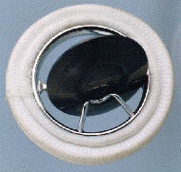
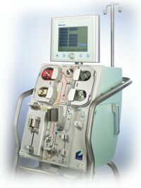
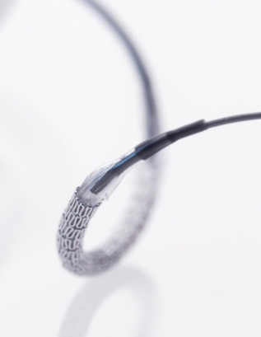
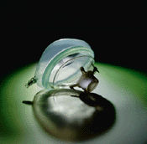

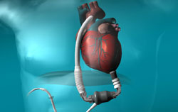
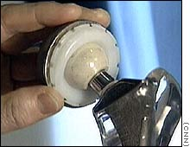
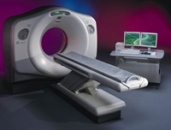
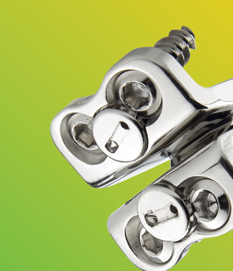
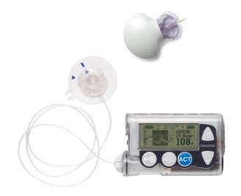
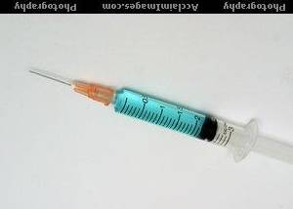
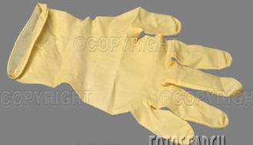
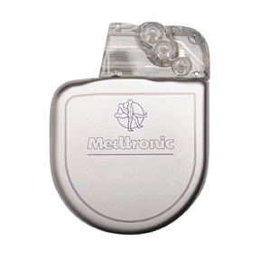
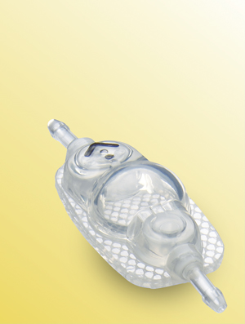

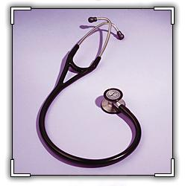

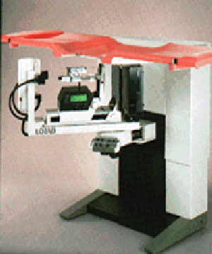

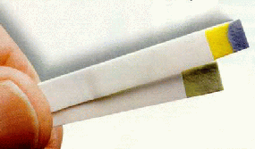
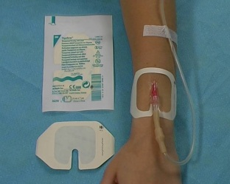

Medical Technology: What Classifies?
Notes:
An easy way to think of medical devices is that they are everything in the hospital except for the people and the drugs.
Basic hospital equipment and tools have been a mainstay of our industry for many years.
Today, our most advanced products are implantable products that work within a patient’s body to regulate the heartbeat, stimulate the nervous system, or replace joints, among other functions.
Advanced diagnostic technologies also are improving patients lives, both by diagnosing disease and quickly monitoring vital statistics, such as the glucose level in a diabetic patient’s bloodstream.
And we also produce a host of very familiar items, such as vision products like contact lenses and eyeglasses, bandages and gauze.
Not shown on this slide are some of the larger diagnostic technologies, such as x-rays, MRIs, and other advanced imaging devices, as well as small implantable devices, such as drug infusion pumps and coronary stents.

Slide 5

Advanced Medical Technology Landscape
Capital Equipment
Implantable/Disposable
Therapeutic
Diagnostic

Slide 6

Devices are NOT Drugs!
 | DRUGS | DEVICES
1 | Based on pharmacology, chemistry, biotechnology, & genetic engineering | Based on mechanical, electrical, IT, and systems engineering
2 | Systemic toxicity | Adverse events most often local in nature
3 | Consumed by use (Metabolized) | Available after use (Stays in the body)
4 | Long-lasting (time-consuming) tests for efficacy and side effects | Thorough evaluation during design-phase
5 | Long Life Cycle justifies length of regulatory process | Rapid Obsolescence and Short Life Cycle
6 | Relatively limited number of products and therapeutic areas | Vastly greater number and diversity of medical of devices. Massive burden of regulation if drug paradigm used
7 | Patients may stop use, non-compliance | Most intended for professional use, higher compliance
8 | Outcome dependent on patient response to therapy | Outcome of intervention also depends on surgeons skills and training
Notes:
Most important 3-4 points
Pictures
ICD/ Diabetes charts
Innovation in business/ high obsolescence – Non-controversial

Slide 7

MedTech: Small Spend; Big Impact
Medical Devices < 5% of Healthcare Expenditures
Medical Technology Competes for:
Health Minister’s Therapy Budget
Finance Minister’s Health System Budget
Mind-Share versus Pharma

Slide 8
Some Macro Drivers
Increased focus on Economic Value
“Democratization” of industry and supply chains, partic in EM
New bus models facilitating flow of tech to base of pyramid
Increasing EM Govt Focus on incentives to bring the industry
Disease management- medtech companies commit to manage entire disease state
Medical tourism—drive for consumer/payer value
Necessity to plan for/execute on PPP’s
Frugal innovation on steroids

Slide 9


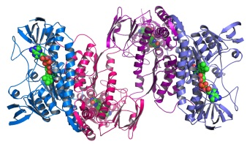
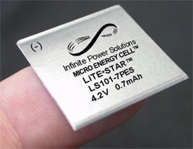
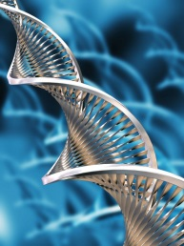

Medtech: Constant Transformation
NEW MATERIALS
Nano Materials
Meta Materials
Biostable Soft Polymer
Bio-erodibles
Conductive Polymers
Shape Memory Alloys
Semi-Conductors
Tissue engineering
TELECOM/IT
Sensors
Telemetry
Low Energy Bluetooth
Handsets
Broadband
Web Architecture
Data Storage
Cloud Computing
Data Analytics
Security
BIOLOGICS
Therapeutic Proteins
Protein Interference
Gene Therapy
Cell Therapy
Advanced Delivery Systems
POWER SOURCES
Thin Film Batteries
Beta Voltaics
Energy Harvesting
Recharge-ability
Transcutaneous Power Transfer
GENOMICS
Rapid Sequencing
Data Analytics
Phenotyping

Slide 10
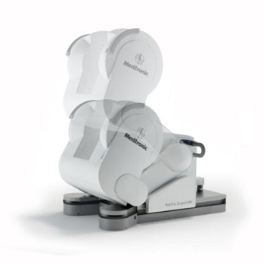
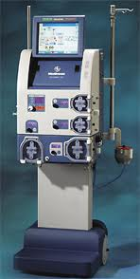
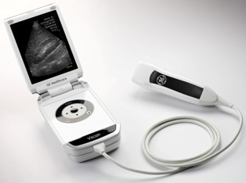
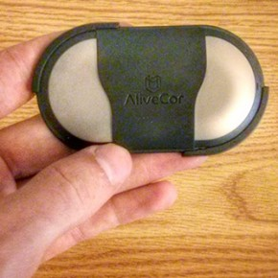
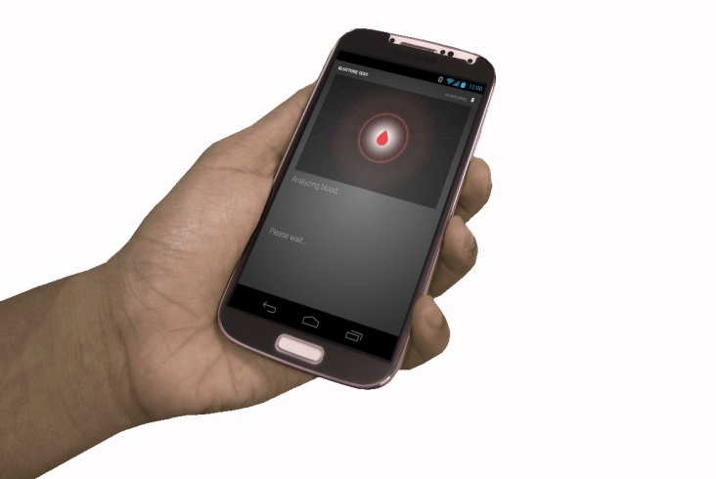

Some Revolutionary EM-Relevant Technologies
InterOperative MRI (.15t vs 1.5t)
VScan
Hemo Dialysis of tomorrow
AliveCor IphoneECG
JanaCare India Diabetes Monitor

Slide 11
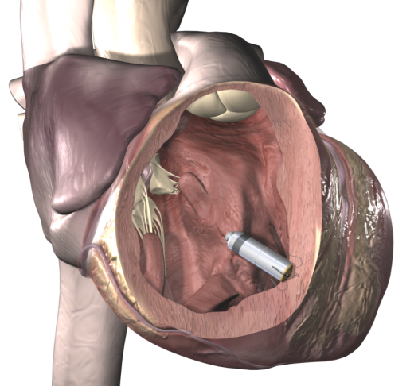
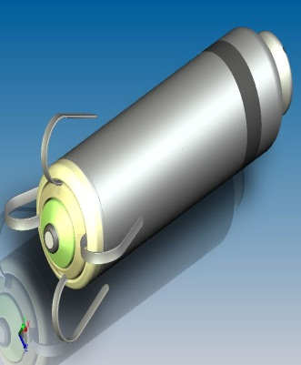
Trans-catheter Pacemaker: Healthcare System Innovation
Patient Preference
Minimally invasive
Access to MRI
Cosmetic appeal
Psychosocial impact
Pain and discomfort
Recovery time
Post-implant restrictions
Radiation exposure
Increase Access to Pacing Therapy
Availability of specialists in emerging markets
Healthcare Utilization/Efficiency
Length of hospital stay
Procedure time
Cath lab utilization
Fewer complications
Percutaneous access
Radiation exposure
Confidential

Slide 12
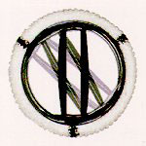
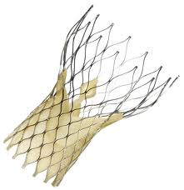
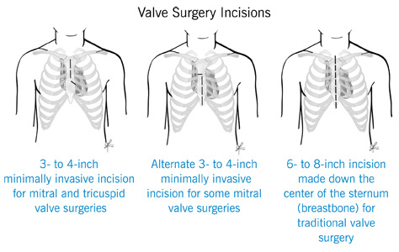
Heart Valve Replacement Innovation
More Cath Lab, Less Open Heart Surgery
Old Technology
New Technology
Impact
Truly Minimally Invasive
Mechanical Valve
‘Minimally Invasive’ Open Heart Surgery (CABG) = 3-4” Chest Incision
Medtronic Corevalve
Reduced Recovery
Trans Catheter Aortic Valve Implantation
Less training for MD required
Cost Savings
Enhanced safety

Slide 13
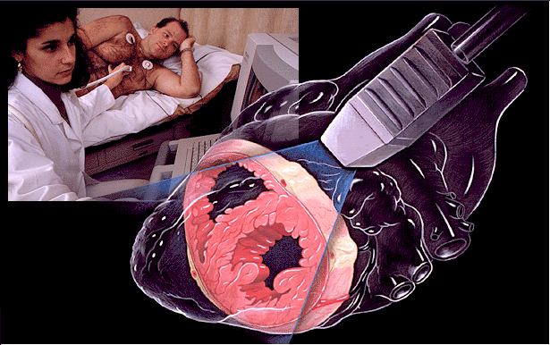
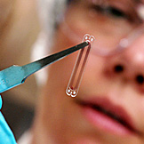
Heart Failure Monitoring Innovation
Less Cath Lab & Hospitalizations, More Home-Monitoring
Old Technology
(In Hospital)
New Technology
(At Home)
Impact
Monitoring HF Patients from Home
Pulmonary Artery Pressure only by Transthoracic Echo, or
St. Jude Cardiomems
Wireless Sensing and Communication
Catheterization monitor
Battery free
Daily measurement
Frees Cath Lab Space
Mobility
Cost savings for HC sys

Slide 14
Medical Devices: Barriers to Patient Access
Intentional & Unintentional
Increased
Patient
Access to
Medical
Devices
Infrastructure
Tariffs
Regulation
Physician Education
Awareness
Procedural Delays
Reimbursement

Slide 15
Technology: Small, but Key Part of Care Continuum

Slide 16

Contact Info
Trevor Gunn
Managing Director- Intl Relations- Medtronic
Trevor.Gunn@Medtronic.com
+1 202 460 0300

